Slide 1
Multithreading

Slide 2
Syllabus
Java thread model
Life Cycle of Thread
Working with Thread class
Runnable interface
Inter thread communication
Synchronization
Notes:
2
Java Programming Handouts

Slide 3
Why Threads?
Improved performance
Minimized system resource usage
Simultaneous access to multiple applications
Program structure simplification
Send & receive data on network
Read & write files to disk
Perform useful computation (editor, browser, game)
Notes:
3

Slide 4



Process Vs Thread
  Process
V
S
  Thread
  Definition
  1. Executable program loaded in memory.
  1. Sequentially executed stream of
  instructions.
  Address Space
  2. Has own address space – variables &
  data structures (in memory)
  2. Shares address space with other
  threads.
Notes:
Threads make possible the implementation of programs that seem to perform multiple tasks at the same time (e.g. multi-threaded Web servers)
4
Java Programming Handouts

Slide 5
Process Vs Thread
  Process
V
S
  Thread
  4. Communicate via operating system, files, network.
  4. Has own execution context.
  5. May contain multiple threads.
  5. Multiple thread in process execute same program.
Notes:
Thread are also termed as Lightweight process – It is considered so because it runs within the context of a full-blown program and takes advantage of the resources allocated for that program and the program's environment.
5
Java Programming Handouts

Slide 6
Types of Thread
Types of Thread
1.
Single Threaded Process
2.
Multi Threaded Process
Notes:
6

Slide 7
Types of Thread (Contd.)
1.
Single Threaded Process
  A thread is defined as the execution of a program.
  A process that is made of one thread is known as single-threaded process.
Single Thread
Notes:
The diagram showing the working of a single thread.
7
Java Programming Handouts

Slide 8
Types of Thread (Contd.)
2.
Multi Threaded Process
  A process that creates two or more threads is called a
  multithreaded process.
Two Threads
Notes:
The diagram show the working of multiple thread.
8
Java Programming Handouts

Slide 9


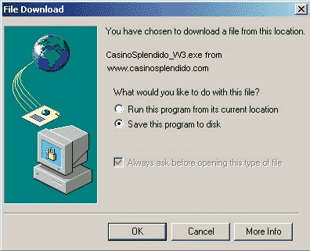

Example on Thread
Notes:
For example, a Central Processing Unit (CPU) performs various tasks simultaneously, such as writing and printing a document, installing a software, and downloading a file from net etc. All these processes are handled by separate threads.
9
Java Programming Handouts

Slide 10



Example on Thread
Web Server
Multiple simultaneous web browser requests
uses threads to handle
Notes:
10

Slide 11

Basic Concepts of MultiTasking
  Multitasking is the ability to execute more than one task at the
  same time.
  Multitasking can be divided into two categories:
1.
Process-based multitasking
2.
Thread-based multitasking
Notes:
Process Based MultiTasking : Process-based multitasking is running two programs concurrently. Programmers refer to a program as a process. Process-based multitasking is can be called as program-based multitasking.
Thread Based Multitasking : Thread-based multitasking is having a program perform two tasks at the same time. For example, a word processing program can check the spelling of words in a document while you write the document. This is thread-based multitasking.
A good way to remember the difference between process-based multitasking and thread-based multitasking is to think of process-based as working with multiple programs and thread-based as working with parts of one program.
11
Java Programming Handouts

Slide 12
Multitasking (Contd.)
1.
Process-based multitasking
  Refers to working with two programs concurrently.
  For example, working with MS-Word, Listening to mp3 song
  using Windows Media Player.
Notes:
Process Based MultiTasking : Process-based multitasking is running two programs concurrently. Programmers refer to a program as a process. Process-based multitasking is can be called as program-based multitasking.
Process-based multitasking has a larger overhead than thread-based multitasking. In process-based multitasking, each process requires its own address space in memory.
The operating system requires a significant amount of CPU time to switch from one process to another process. This is known as context-switching.
12
Java Programming Handouts

Slide 13
Multitasking (Contd.)
2.
Thread-based multitasking
  Refers to working with parts of one program.
  For example, MS-Word program can check spelling, count line
  numbers, column number while writing in a document.
Notes:
Thread Based Multitasking : Thread-based multitasking is having a program perform two tasks at the same time. For example, a word processing program can check the spelling of words in a document while you write the document.
Thread-based multitasking share the same address space in memory because they share the same program. This also has an impact on context switching, because switching from one part of the program to another happens within the same address space in memory.
13
Java Programming Handouts

Slide 14
Disadvantage of Multi Threading
  Race condition
  Deadlock condition
  Lock starvation
Notes:
Race Condition : Two or more threads access to same object and each call a method that modifier the state of the object. Corrupted object result!
Deadlock describes a situation where two or more threads are blocked forever, waiting for each other.
Starvation describes a situation where a thread is unable to gain regular access to shared resources and is unable to make progress. This happens when shared resources are made unavailable for long periods by "greedy" threads. For example, suppose an object provides a synchronized method that often takes a long time to return. If one thread invokes this method frequently, other threads that also need frequent synchronized access to the same object will often be blocked.
Livelock
A thread often acts in response to the action of another thread. If the other thread's action is also a response to the action of another thread, then livelock may result. As with deadlock, livelocked threads are unable to make further progress. However, the threads are not blocked — they are simply too busy responding to each other to resume work. This is comparable to two people attempting to pass each other in a corridor. Joy moves to his left to let Raj pass, while Raj moves to his right to let Joy pass. Seeing that they are still blocking each other, Joy moves to his right, while Raj moves to his left. They're still blocking each other, so...
14
Java Programming Handouts

Slide 15
Using Threads in Java
How To Use Threads in Java
Using Thread
class
java.lang.Thread class is used to construct and access individuals thread in a multi threaded application.
Notes:
15
Java Programming Handouts

Slide 16
Using Threads in Java (Contd.)
Thread Class Declaration
  public class Thread extends Object
  implements Runnable {
  public Thread();
  public Thread(String name); // Thread name
  public Thread(Runnable r); // Thread ⇒ r.run()
  public Thread(Runnable r, String name);
  public void run();
  public void start(); // begin thread execution
  ...
  }
Notes:
16

Slide 17

Life Cycle of a Thread
Refers to current class object
New
Created by instantiating the Thread class.
Thread th=new Thread (this);
Runnable
By calling the start() method that in turn call run() method.
th.start();
Not Runnable
Calling wait() or sleep() method or caused due to IO interrupts.
th.wait();
th.sleep(1000);
Dead or Terminate
After the run() method completes execution.
public void run { …… }
Notes:
Runnable does not imply the Runnable interface. It is just the running state of a thread.
17
Java Programming Handouts

Slide 18



States of thread
New Born
Running
Blocked
Runnable
Thread th=new Thread (this);
// this happened only once
Notify(), notifyall(), join(), wake up from sleep();
Calling wait(), Sleep(),
Th.start()
Execute run();
Thread is moving from Runnable to Running and Running to Runnable state until run method execute completely

Slide 19
Java Thread States (Contd.)
State Diagram
new
start
new
runnable
notify, notifyAll,
IO complete, sleep expired,
join complete
scheduler
yield,
time slice
running
blocked
IO, sleep,
wait, join
terminate
dead

Slide 20
Creating Threads
Creating Threads
  Two ways of creating Thread in Java:
1.
Extending from java.lang.Thread class
2.
Implementing the Runnable Interface
Notes:
20

Slide 21
Creating Threads (Contd.)
1.
Extending from java.lang.Thread class
The class extending the Thread class calls start() method to begin
executing child thread.
Sample Code
public class MyThread extends Thread {
  public void run() {
  …
  }
  }
  MyThread T = new MyThread () ; // create thread
  T.start(); // begin running thread
  …
Notes:
21
Java Programming Handouts

Slide 22
Creating Threads (Contd.)
1.
Extending from java.lang.Thread class
Code to create Thread using Thread class
for (int i = 0; i < =5; i++) {
System.out.println(name + " says: " + msg+” for “+i+” time/s”);
try {
Thread.sleep(2000);
}
catch (InterruptedException ie) {}
}// End of For Loop
System.out.println(name + " finished execution");
}
}
class MyThread extends Thread {
private String name, msg;
public MyThread(String name, String msg) {
this.name = name;
this.msg = msg;
}
public void run() {
System.out.println(name + " starts its execution");
Notes:
22
Java Programming Handouts

Slide 23
Creating Threads (Contd.)
1.
Extending from java.lang.Thread class
class MyThread extends Thread {
private String name, msg;
public MyThread(String name, String msg) {
this.name = name;
this.msg = msg;
}
public void run() {
System.out.println(name + " starts its execution");
for (int i = 0; i < =5; i++) {
System.out.println(name + " says: " + msg+” for “+i+” time/s”);
try {
Thread.sleep(2000);
}
catch (InterruptedException ie) {}
}// End of For Loop
System.out.println(name + " finished execution");
}
}
Notes:
23
Java Programming Handouts

Slide 24
Creating Threads (Contd.)
1.
Extending from java.lang.Thread class
class MyThread extends Thread {
private String name, msg;
public MyThread(String name, String msg) {
this.name = name;
this.msg = msg;
}
public void run() {
System.out.println(name + " starts its execution");
for (int i = 1; i < =5; i++) {
System.out.println(name + " says: " + msg+” for “+i+” time/s”);
try {
Thread.sleep(2000);
}
catch (InterruptedException ie) {}
}// End of For Loop
System.out.println(name + " finished execution");
}
}
Overridden Method
Notes:
24
Java Programming Handouts

Slide 25
Creating Threads (Contd.)
1.
Extending from java.lang.Thread class
class MyThread extends Thread {
private String name, msg;
public MyThread(String name, String msg) {
this.name = name;
this.msg = msg;
}
public void run() {
System.out.println(name + " starts its execution");
for (int i = 1; i < =5; i++) {
System.out.println(name + " says: " + msg+” for “+i+” time/s”);
try {
Thread.sleep(2000);
}
catch (InterruptedException ie) {}
}// End of For Loop
System.out.println(name + " finished execution");
}
}
It will throw an InterruptedException
Notes:
25
Java Programming Handouts

Slide 26
Creating Threads (Contd.)
1.
Extending from java.lang.Thread class
class MyThread extends Thread {
private String name, msg;
public MyThread(String name, String msg) {
this.name = name;
this.msg = msg;
}
public void run() {
System.out.println(name + " starts its execution");
for (int i = 1; i < =5; i++) {
System.out.println(name + " says: " + msg+” for “+i+” time/s”);
try {
Thread.sleep(2000);
}
catch (InterruptedException ie) {}
}// End of For Loop
System.out.println(name + " finished execution");
}
}
Caught by
Notes:
java.lang.InterruptedException class is an Checked Exception derived from java.lang.Exception class.
It is thrown when a thread is waiting, sleeping, or otherwise paused for a long time and another thread interrupts it using the interrupt method in class Thread.
26
Java Programming Handouts

Slide 27
Creating Threads (Contd.)
1.
Extending from java.lang.Thread class
How to Use Our Thread that we have created
Notes:
java.lang.InterruptedException class is an Checked Exception derived from java.lang.Exception class.
It is thrown when a thread is waiting, sleeping, or otherwise paused for a long time and another thread interrupts it using the interrupt method in class Thread.
27
Java Programming Handouts

Slide 28
Creating Threads (Contd.)
1.
Extending from java.lang.Thread class
public class TestMyThread
{
public static void main(String[] args)
{
MyThread mth1 = new MyThread(“SICS", “Hello");
mth1.start();
}
}
Notes:
28
Java Programming Handouts

Slide 29
Creating Threads (Contd.)
1.
Extending from java.lang.Thread class
public class TestMyThread
{
public static void main(String[] args)
{
MyThread mth1 = new MyThread(“SICS", “Hello");
mth1.start();
}
}
A New Thread Created But Not Running
Notes:
29
Java Programming Handouts

Slide 30
Creating Threads (Contd.)
1.
Extending from java.lang.Thread class
run() method is called.
The New Thread moves to runnable state or to the running state depending upon the scheduler.
public class TestMyThread
{
public static void main(String[] args)
{
MyThread mth1 = new MyThread(“SICS", “Hello");
mth1.start();
}
}
Notes:
A Thread is newly created.
30
Java Programming Handouts

Slide 31
Creating Threads (Contd.)
1.
Extending from java.lang.Thread class
Can U Predict The Output of the Program
Notes:
31
Java Programming Handouts

Slide 32
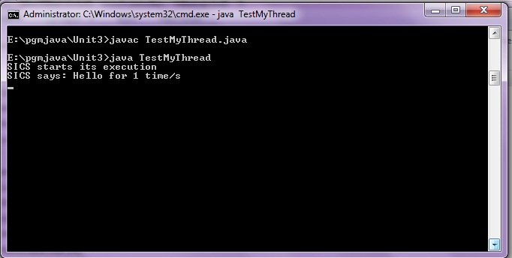
Creating Threads (Contd.)
1.
Extending from java.lang.Thread class
Notes:
32
Java Programming Handouts

Slide 33
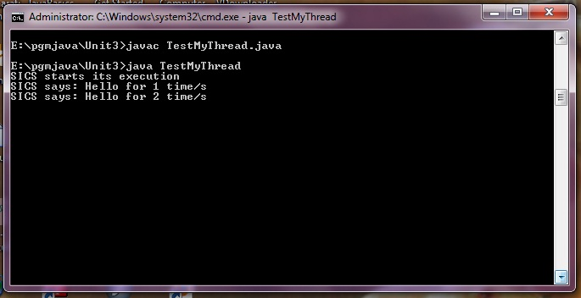
Creating Threads (Contd.)
1.
Extending from java.lang.Thread class
Notes:
33
Java Programming Handouts

Slide 34
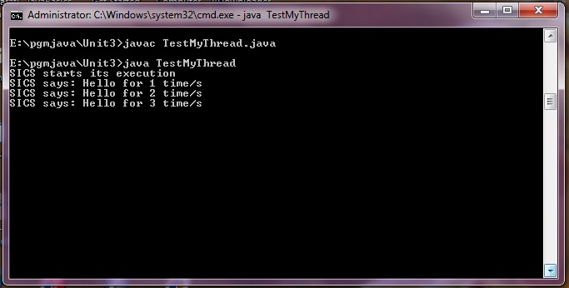
Creating Threads (Contd.)
1.
Extending from java.lang.Thread class
Notes:
34
Java Programming Handouts

Slide 35
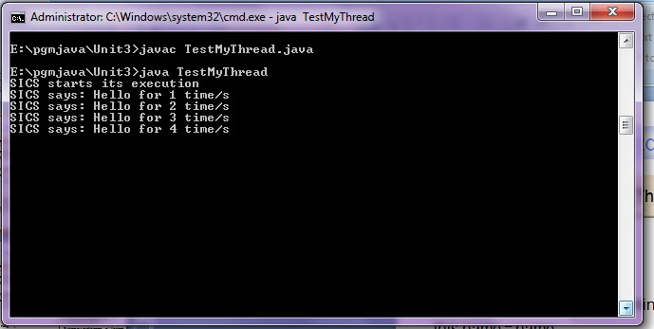
Creating Threads (Contd.)
1.
Extending from java.lang.Thread class
Notes:
35
Java Programming Handouts

Slide 36
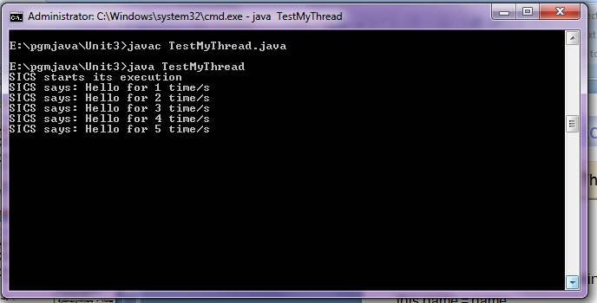
Creating Threads (Contd.)
1.
Extending from java.lang.Thread class
Notes:
36
Java Programming Handouts

Slide 37
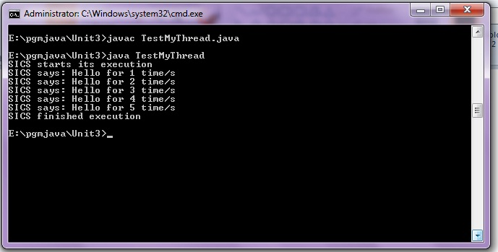
Creating Threads (Contd.)
1.
Extending from java.lang.Thread class
Notes:
37
Java Programming Handouts

Slide 38
Creating Threads (Contd.)
2.
Implementing the Runnable Interface
The Runnable interface only consists of run() method.
When a program needs to be inherited from a class other than Thread
class, you need to implement the Runnable interface.
Sample Code
public class MyRunnableThread implements Runnable {
  public void run() {
  … // work for thread
  }
  }
  Thread T = new Thread(new MyT()); // create thread
  T.start(); // begin running thread
  …
Notes:
38
Java Programming Handouts

Slide 39
Creating Threads (Contd.)
2.
Implementing the Runnable Interface
Code to create Thread using Runnable Interface
for (int i = 1; i < =5; i++) {
System.out.println(name + " says: " + msg+” for “+i+” time/s”);
try {
Thread.sleep(2000);
}
catch (InterruptedException ie) {}
}// End of For Loop
System.out.println(name + " finished execution");
}
}
class MyRunnableThread implements Runnable {
private String name, msg;
public MyRunnableThread(String name, String msg) {
this.name = name;
this.msg = msg;
}
public void run() {
System.out.println(name + " starts its execution");
Notes:
39
Java Programming Handouts

Slide 40
Creating Threads (Contd.)
2.
Implementing the Runnable Interface
class MyRunnableThread implements Runnable {
private String name, msg;
public MyRunnable(String name, String msg) {
this.name = name;
this.msg = msg;
}
public void run() {
System.out.println(name + " starts its execution");
for (int i = 1; i < =5; i++) {
System.out.println(name + " says: " + msg+” for “+i+” time/s”);
try {
Thread.sleep(2000);
}
catch (InterruptedException ie) {}
}// End of For Loop
System.out.println(name + " finished execution");
}
}
Notes:
40
Java Programming Handouts

Slide 41
Creating Threads (Contd.)
2.
Implementing the Runnable Interface
class MyRunnableThread implements Runnable {
private String name, msg;
public MyRunnable(String name, String msg) {
this.name = name;
this.msg = msg;
}
public void run() {
System.out.println(name + " starts its execution");
for (int i = 1; i < =5; i++) {
System.out.println(name + " says: " + msg+” for “+i+” time/s”);
try {
Thread.sleep(2000);
}
catch (InterruptedException ie) {}
}// End of For Loop
System.out.println(name + " finished execution");
}
}
Defining the behavior of run method declared in the Runnable interface
Notes:
Implemented the Runnable interface in MyRunnable class.
MyRunnable class instance represents an Runnable object that will be passed as an argument in the Thread class constructor. Then by using the Thread class object you can make a call to start() method that will in turn call the run() method define inside the MyRunnable class.
41
Java Programming Handouts

Slide 42
Creating Threads (Contd.)
2.
Implementing the Runnable Interface
public class TestRunnableThread
{
public static void main(String[] args)
{
MyRunnableThread mrt = new MyRunnableThread(“SICS“,“Hello");
Thread t1 = new Thread(mrt);
t1.start();
}
}
Notes:
42
Java Programming Handouts

Slide 43
Creating Threads (Contd.)
2.
Implementing the Runnable Interface
A New Runnable object is created
public class TestMyRunnable
{
public static void main(String[] args)
{
MyRunnable mrt = new MyRunnable(“SICS", “Hello");
Thread t1 = new Thread(mrt);
t1.start();
}
}
Notes:
43
Java Programming Handouts

Slide 44
Creating Threads (Contd.)
2.
Implementing the Runnable Interface
A New Thread is created
public class TestMyRunnable
{
public static void main(String[] args)
{
MyRunnable mrt = new MyRunnable(“SICS", “Hello");
Thread t1 = new Thread(mrt);
t1.start();
}
}
Notes:
44
Java Programming Handouts

Slide 45
Creating Threads (Contd.)
2.
Implementing the Runnable Interface
A newly created thread is moved either to runnable or running state by the scheduler
public class TestMyRunnable
{
public static void main(String[] args)
{
MyRunnable mrt = new MyRunnable(“SICS", “Hello");
Thread t1 = new Thread(mrt);
t1.start();
}
}
Notes:
45
Java Programming Handouts

Slide 46
Creating Threads (Contd.)
2.
Implementing the Runnable Interface
Same Output As In The Case Of TestMyThread class
Notes:
46
Java Programming Handouts

Slide 47
Java MultiThreading Example (Contd.)
Sample Code
  public class MultiThreadExample extends Thread {
  public void run() {
  for (int i = 0; i < 3; i++)
  System.out.println(i);
  try {
  sleep((int)(Math.random() * 5000)); // sleep for 5 seconds.
  } catch (InterruptedException e) { }
  }
  public static void main(String[] args) {
  new MultiThreadExample().start();
  new MultiThreadExample().start();
  System.out.println("Done");
  }
  }
Notes:
47
Java Programming Handouts

Slide 48
Java MultiThreading Example
Possible Outputs
0, 1, 2, 0, 1, 2, Done
// thread1, thread2, main()
0, 1, 2, Done, 0, 1, 2
// thread1, main(), thread2
Done, 0, 1, 2, 0, 1, 2
// main(), thread1, thread2
0, 0, 1, 1, 2, Done, 2
// main() & threads interleaved
Notes:
48

Slide 49
Using Threads in Java
Point To Be Noted
The first thread to be executed in a multithreaded process is called the main thread.
The main thread is created automatically on the startup of java program execution.
Notes:
The execution of those threads depends on the Scheduler. The type of scheduling used is Preemptive Scheduling, i.e. depending upon the priority of the thread get chances to execute.
49
Java Programming Handouts

Slide 50
Controlling the main thread
Controlling the main Thread.
class CurrentThreadDemo {
public static void main(String args[]) {
Thread t = Thread.currentThread();
System.out.println("Current thread: " + t);
// change the name of the thread
t.setName("My Thread");
System.out.println("After name change: " + t);
try {
for(int n = 5; n > 0; n--) {
System.out.println(n);
Thread.sleep(1000);
}
} catch (InterruptedException e) {
System.out.println("Main thread interrupted");
}
}
}
Notes:
50
Java Programming Handouts

Slide 51
Threads Scheduling
Scheduling
The execution of multiple threads on a single CPU is called scheduling.
Determines which runnable threads to run
Can be based on thread priority
Part of OS or Java Virtual Machine (JVM)
The Java runtime supports a very simple, deterministic scheduling algorithm known as fixed priority scheduling.
Notes:
Types of Scheduling:-
Preemptive
Non-Preemptive
In Non-Preemptive Scheduling, Threads continue execution until
1. Thread terminates
2. Executes instruction causing wait (e.g., IO)
3. Thread volunteering to stop (invoking yield or sleep)
In Preemptive Scheduling, Threads continue execution until,
Preemted by Scheduler
Same reasons as Non-Preemptive Scheduling
51
Java Programming Handouts

Slide 52
Thread Priority
Thread priorities are the integers in the range of 1 to 10 that specify the priority of one thread with respect to the priority of another thread.
Each Java thread is given a numeric priority between MIN_PRIORITY and MAX_PRIORITY.
The Java Run-time system selects the runnable thread with the highest priority of execution when a number of threads get ready to execute.
The Java Run-time Environment executes threads based on their priority.
A thread with higher priority runs before threads with low priority.
A given thread may, at any time, give up its right to execute by calling the yield method. Threads can only yield the CPU to other threads of the same priority--attempts to yield to a lower priority thread are ignored.
Notes:
Thread class has three int static fields namely MIN_PRIORITY with value 1, NORM_PRIORITY with value 5 , MAX_PRIORITY with value 10.
Scheduling of the CPU is fully preemptive.
A CPU can execute only one thread at a time. Therefore, the threads, which are ready for execution, queue up for their turn to get executed by the processor.
The Java runtime will not preempt the currently running thread for another thread of the same priority. In other words, the Java runtime does not time-slice.
The system implementation of threads underlying the Java Thread class may support time-slicing. Do not write code that relies on time-slicing.
52
Java Programming Handouts

Slide 53
Thread Priority (Contd.)
Setting Thread Priority
You can set the thread priority after it is created using the setPriority() method declared in the Thread class.
Syntax for setPriority method
  public final void setPriority (int newPriority)
Notes:
53
Java Programming Handouts

Slide 54
Thread Priority Example
class C extends Thread
{
public void run()
{
System.out.println("Thread C started");
for(int k=1;k<=4;k++)
{
System.out.println("\t From ThreadC: k= "+k);
}
System.out.println("Exit from C");
}
}
class ThreadPriority
{
public static void main(String args[])
{
A threadA=new A();
B threadB=new B();
C threadC=new C();
threadC.setPriority(Thread.MAX_PRIORITY);
threadB.setPriority(threadA.getPriority()+1);
threadA.setPriority(Thread.MIN_PRIORITY);
System.out.println("Started Thread A");
threadA.start();
System.out.println("Started Thread B");
threadB.start();
System.out.println("Started Thread C");
threadC.start();
System.out.println("End of main thread");
}
}
54
Notes:
54

Slide 55


Why Synchronization?
Thread Synchronization
Problem:
Race condition!
Two or more threads access to same object and each call a method that modifies the state of the object.
Result: Corrupted object
Notes:
55

Slide 56

What is the Solution?
Thread Synchronization (Contd.)
Synchronization
Notes:
56

Slide 57
Thread Synchronization (Contd.)
Unsynchronized
Synchronized
Thread 1
Thread 2
Thread 1
Thread 2
Time
Transfer
Transfer
Transfer
Transfer
Notes:
If two threads can both execute a method that modifies the state of an object then the method should be declared to be synchronized, allowing only one thread to execute the method at a time.
If two threads can both execute a method that modifies the state of an object then the method should be declared to be synchronized, allowing only one thread to execute the method at a time.
When a thread calls the wait() method, it temporarily releases the locks that it holds. In addition, the thread stops running and is added to the list of waiting threads for that object.
Note: If a class has at least one synchronized methods, each instance of it has a monitor.
57
Java Programming Handouts

Slide 58
Thread Synchronization (Contd.)
What is Synchronization?
    Synchronization of threads ensures that if two or more threads need to access a shared resource then that resource is used by only one thread at a time.
    Synchronization is based on the concept of monitor.
What is a Monitor?
A monitor is an object that can block threads and notify them when it is available.
    The monitor controls the way in which synchronized methods access an object or class.
    To enter an object’s monitor, you need to call a synchronized method.

Slide 59
Accessing Shared Resources
Applications Access to Shared Resources need to be coordinated.
  Printer (two person jobs cannot be printed at the same time)
  Simultaneous operations on your bank account.
  Can the following operations be done at the same time on the same account?
    Deposit()
    Withdraw()
    Enquire()
59

Slide 60






Online Bank: Serving Many Customers and Operations
PC client
Internet Bank Server
Local Area Network
Bank
Database
PDA
60

Slide 61
How To Achieve Synchronization?
Thread Synchronization (Contd.)
Using
synchronized keyword
Object Locks
  Keyword : synchronized

Slide 62
Synchronization can be achieved at two levels
Thread Synchronization (Contd.)
1. Method Level
2. Object Level

Slide 63
1. Synchronizing A Method
Thread Synchronization (Contd.)
public synchronized void updateRecord()
{
// critical code goes here …
}

Slide 64

1. Synchronizing A Method
Thread Synchronization (Contd.)
public synchronized void updateRecord()
{
// critical code goes here …
}
Only one thread will be inside the body of the updateRecord() method. The second call will be blocked until the first call returns or wait() is called inside the synchronized method.
Notes:
wait():- The wait() method is a part of java.lang.Object class that tells a thread to relinquish a monitor and go into suspension.
There are two forms of the wait() method. One form is mentioned above that doesn’t require an argument and causes a thread to wait until it is notified. The other form of the wait() method let’s you specify the amount of time to wait. You specify the length of time in milliseconds, which is passed to the wait() method.
notify():- The notify() method is part of java.lang.Object class that tells a thread that is suspended by the wait() method to wake up again and regain control of the monitor.
notifyAll():- The notifyAll() method belongs to java.lang.Object class that wakes up all threads that are waiting for control of the monitor.
64
Java Programming Handouts

Slide 65
2. Synchronizing An Object
Thread Synchronization (Contd.)
public void updateRecord()
{
synchronized (this)
{
// critical code goes here …
}
}
Notes:
65

Slide 66
2. Synchronizing An Object
Thread Synchronization (Contd.)
public void updateRecord()
{
synchronized (this)
{
// critical code goes here …
}
}
Notes:
66

Slide 67
the driver: 3rd Threads sharing the same object
class InternetBankingSystem {
public static void main(String [] args ) {
Account accountObject = new Account ();
Thread t1 = new Thread(new MyThread(accountObject));
Thread t2 = new Thread(new YourThread(accountObject));
Thread t3 = new Thread(new HerThread(accountObject));
t1.start();
t2.start();
t3.start();
// DO some other operation
} // end main()
}
67
Notes:
67

Slide 68
Shared account object between 3 threads
class MyThread implements Runnable {
Account account;
public MyThread (Account s) { account = s;}
public void run() { account.deposit(); }
} // end class MyThread
class YourThread implements Runnable {
Account account;
public YourThread (Account s) { account = s;}
public void run() { account.withdraw(); }
} // end class YourThread
class HerThread implements Runnable {
Account account;
public HerThread (Account s) { account = s; }
public void run() {account.enquire(); }
} // end class HerThread
account
(shared object)
68

Slide 69
Monitor (shared object access): serializes operation on shared object
class Account { // the 'monitor'
int balance;
  // if 'synchronized' is removed, the outcome is unpredictable
  public synchronized void deposit( ) {
  // METHOD BODY : balance += deposit_amount;
  }
  public synchronized void withdraw( ) {
  // METHOD BODY: balance -= deposit_amount;
  }
  public synchronized void enquire( ) {
  // METHOD BODY: display balance.
  }
}
69

Slide 70
Inside Monitors
addPrimeToCache
PrimeCache
primes
maxPrime
run
main
isPrime
Copyright © 2002, DeLorme

Slide 71
Inside Monitors
addPrimeToCache
PrimeCache
primes
maxPrime
main
run
isPrime
Copyright © 2002, DeLorme

Slide 72
Inside Monitors
addPrimeToCache
PrimeCache
primes
maxPrime
main
isPrime
Copyright © 2002, DeLorme

Slide 73
Inside Monitors
addPrimeToCache
PrimeCache
primes
maxPrime
main
isPrime
Copyright © 2002, DeLorme

Slide 74
Inside Monitors
addPrimeToCache
PrimeCache
primes
maxPrime
isPrime
Copyright © 2002, DeLorme

Slide 75
InterThread Communication
What is Interthread communication?
    A thread may notify another thread that the task has been completed. This communication between threads is known as interthread communication.
    The various methods used in interthread communication are:
      wait()
      notify()
      notifyAll()
Notes:
75

